Slide 1
A Minute on
FERPA

Slide 2
FERPA provides Students with
4 Basic Rights
1. The right to inspect and review the student’s educational records within 45 days from the College receiving the request for access. A “Request to Review Student Education Record” form is available in and must be submitted to the Office of the Registrar.
2. The right to request the amendment of the student’s educational records that the student believes are inaccurate or misleading.
3. The right to consent to disclosures of personally identifiable information contained in the student’s educational records, except to the extent that FERPA authorizes disclosure without consent.
4. The right to file a complaint with the U. S. Department of Education concerning alleged failures by the College to comply with the requirements of FERPA.
More detailed information about these 4 rights is available in the 2009-2010 Flagler College Catalog on pages 134-135.

Slide 3
Education Record
What is an education record?
  Any record maintained by the institution from which a student can be personally identified (can include, but is not limited to, below items).
    Grades
    Schedules
    Transcripts
    LMS information
    Advising information
    Financial Aid information
    Student billing information
    Student photos
    Advising File

Slide 4
FAQs
Who is a School Official?
  Someone Flagler College has employed, contracted with, or has an official relationship with who would need to access pertinent educational data to perform his/her designated job functions.
I have access to information that I do not need to perform my duties/functions, can I legally view, use, share, or disseminate this information?
  No, even though you have access to information, you are not legally able to view, use, share, or disseminate the information; you’re on your honor to keep that information secure.
What is Directory Information?
  Directory information is information that is generally not considered harmful or an invasion of privacy if released, it can also be disclosed to outside organizations without a student's prior written consent.
I have been asked to release student information and do not know whether I can even with a FERPA Release; what should I do?
  Contact the Office of the Registrar (x-372) for clarification. Its better to be safe than sorry!

Slide 5
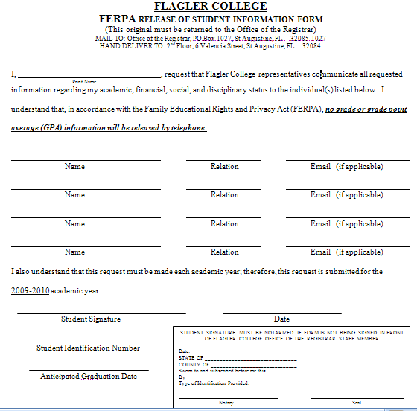

Slide 6
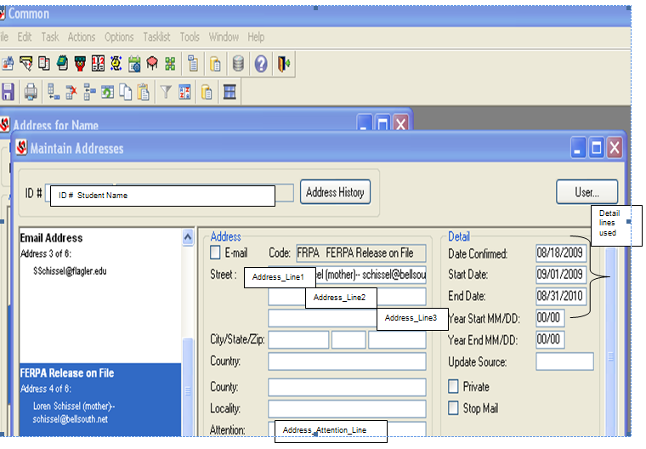
Is a Release on File?

